Slide 1
Erdős Institute Data Science bootcamp 2023:
Predicting subscription to a term deposit.
Team 11: Drew D. Ash, Laura Brade, Jamie Kimble

Slide 2
Framing the problem and data
Statement of problem: Given specific data about a person, how likely are they to subscribe to a term deposit with this Portuguese bank?
Key stakeholders: This specific bank is the primary stakeholder. The model, however, could be adapted to different datasets and different questions revolving around any consumer or customer base.
Data: https://archive.ics.uci.edu/ml/datasets/Bank+Marketing
Code and materials: https://github.com/DrewAsh13/Erdos-2023_Project

Slide 3
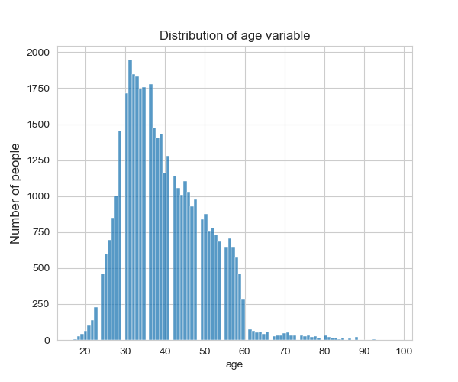
Exploring the data and preprocessing

Slide 4
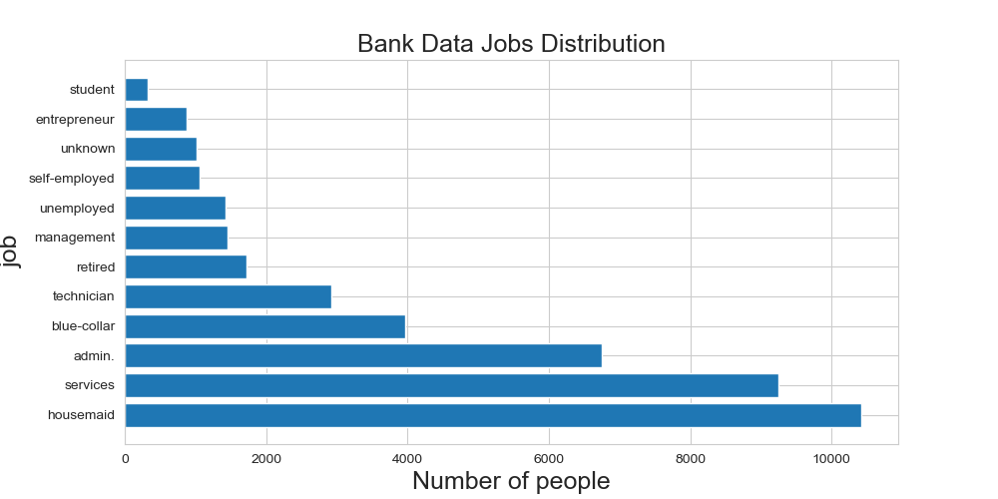
EDA continued

Slide 5
Model Choices, metrics and outcomes
Model | Precision | Recall | True Positive Rate (TPR) | False Negative Rate (FNR)
Logistic Reg. | 0.6442 | 0.2166 | 0.2166 | 0.7834
KNN | 0.5274 | 0.2802 | 0.2802 | 0.7198
Decision Tree | 0.6745 | 0.1853 | 0.6745 | 0.3255
Random Forest | 1 | 0.0011 | 1 | 0
Support Vector Machine (SVM)

Slide 6
Final choice and recommendations
Recommended Model: Decision Tree
Highest TPR and FNR
Given that roughly 11% of contacted people deposited money, having high TPR and low FNR is essential to this problem.
Transparency
The decision tree model is transparent in that it outputs how it made choices to classify will deposit or will not deposit. We can use these insights to better inform the next direct marketing campaign.

Slide 7
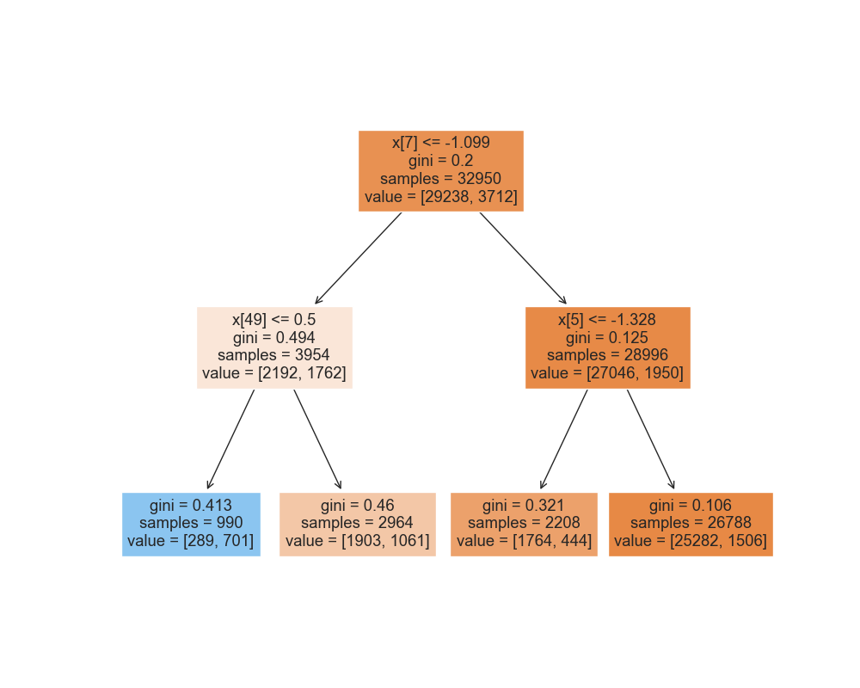
Decision Tree

Slide 8
Future Directions
Tuning hyperparameters
Revisiting the random forest model to double check for overfitting.
Experiment with various other KNN models
Try different depths on the decision tree
Feature selection
Try other classification models
Neural Networks
SVM
Data: https://archive.ics.uci.edu/ml/datasets/Bank+Marketing
Code and materials: https://github.com/DrewAsh13/Erdos-2023_Project

